Slide 1


HashiCorp Corporate Overview
William Patton - Solutions Engineer william@hashicorp.com @wpatton

Slide 2
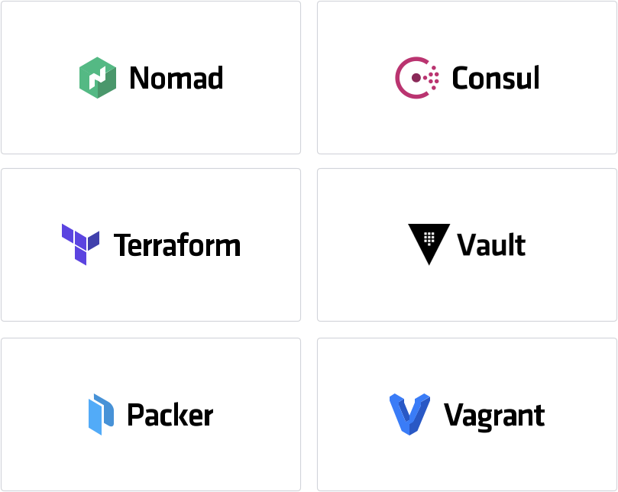
Company Overview
Founded in 2012 by Mitchell Hashimoto and Armon Dadgar
Enabling the Cloud Operating Model Provision, Secure, Connect, and Run any infrastructure for any application

Slide 3
Implications of the Cloud Operating Model
STATIC
DYNAMIC
Dedicated servers
Homogenous
Capacity on-demand
Heterogenous
Provision

Slide 4
Implications of the Cloud Operating Model
STATIC
DYNAMIC
High trust
IP-based
Low trust
Identity-based
Secure
Dedicated servers
Homogenous
Capacity on-demand
Heterogenous
Provision

Slide 5
Implications of the Cloud Operating Model
STATIC
DYNAMIC
Host-based
Static IP
Service-based
Dynamic IP
Connect
High trust
IP-based
Low trust
Identity-based
Secure
Dedicated servers
Homogenous
Capacity on-demand
Heterogenous
Provision

Slide 6
Implications of the Cloud Operating Model
STATIC
DYNAMIC
Run
Dedicated Infrastructure
Scheduled across the fleet
Host-based
Static IP
Service-based
Dynamic IP
Connect
High trust
IP-based
Low trust
Identity-based
Secure
Dedicated servers
Homogenous
Capacity on-demand
Heterogenous
Provision

Slide 7
The Cloud Landscape
STATIC
DYNAMIC
Dedicated
Private Cloud
AWS
Azure
GCP
Run
Development
vSphere
vSphere
EKS/ECS Lambda
AKS/ACS Azure Functions
GKE Cloud Functions
Connect
Networking
Hardware
Various Hardware
Proprietary
Proprietary
Proprietary
Secure
Security
IP: Hardware
Identity: AD/LDAP
Identity: AWS IAM
Identity: Azure AD
Identity: GCP IAM
Provision
Operations
vCenter
vSphere
EKS/ECS Lambda
AKS/ACS Azure Functions
GKE Cloud Functions

Slide 8
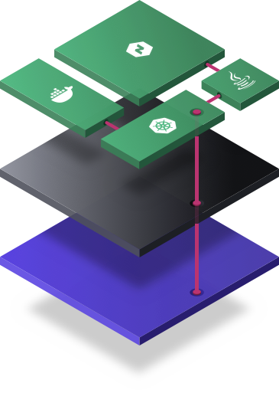

A Common Operating Model with the HashiCorp Suite
Private Cloud
AWS
Azure
GCP
Run
Development
Connect
Networking
Secure
Security
Provision
Operations

Slide 9

Cloud Provisioning with Terraform
A common Cloud Operating Model
Private Cloud
AWS
Azure
GCP
Run
Development
Connect
Networking
Secure
Security
Provision
Operations

Slide 10
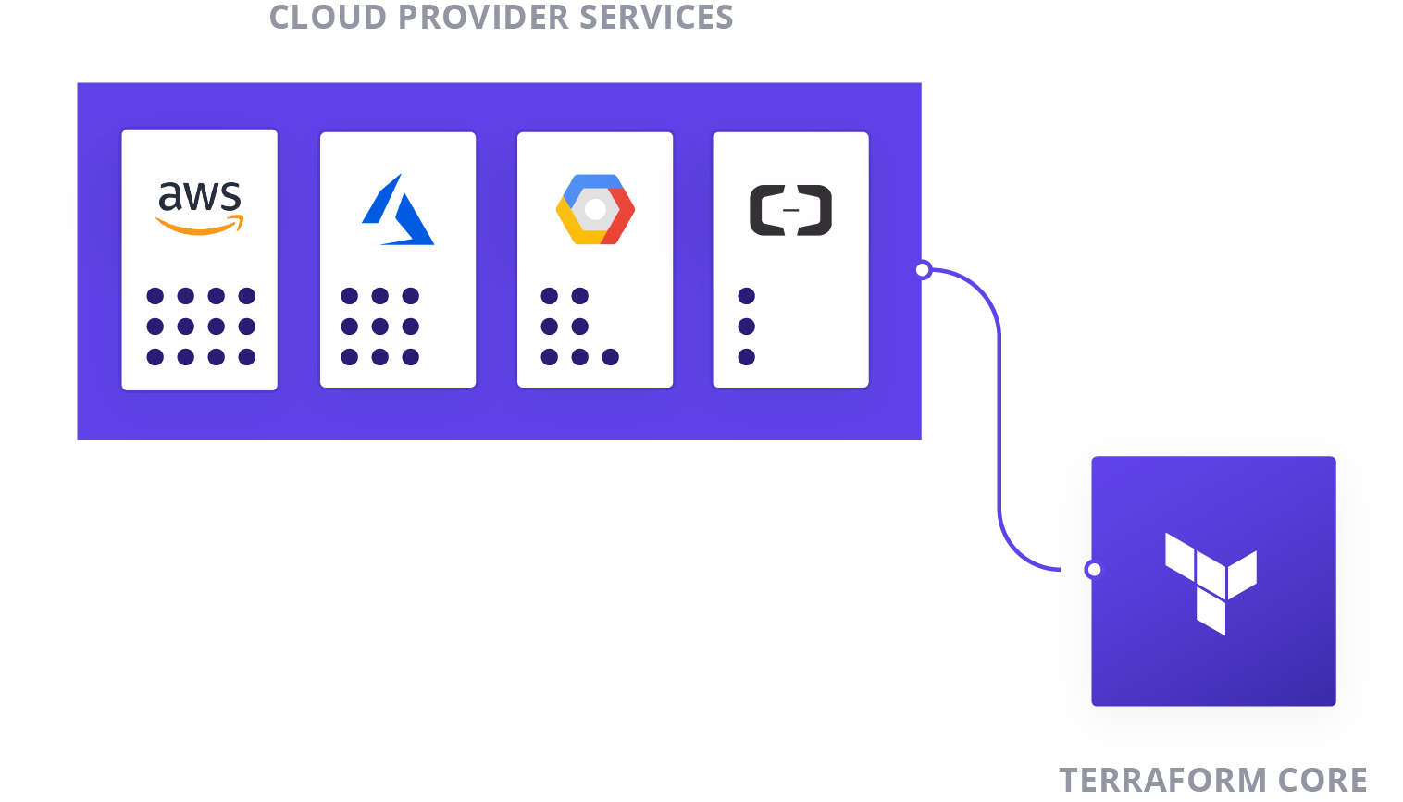
Cloud Provisioning with Terraform
A common Cloud Operating Model
Core + Provider Model
Expose the unique services of each infrastructure platform, but provide a consistent workflow

Slide 11
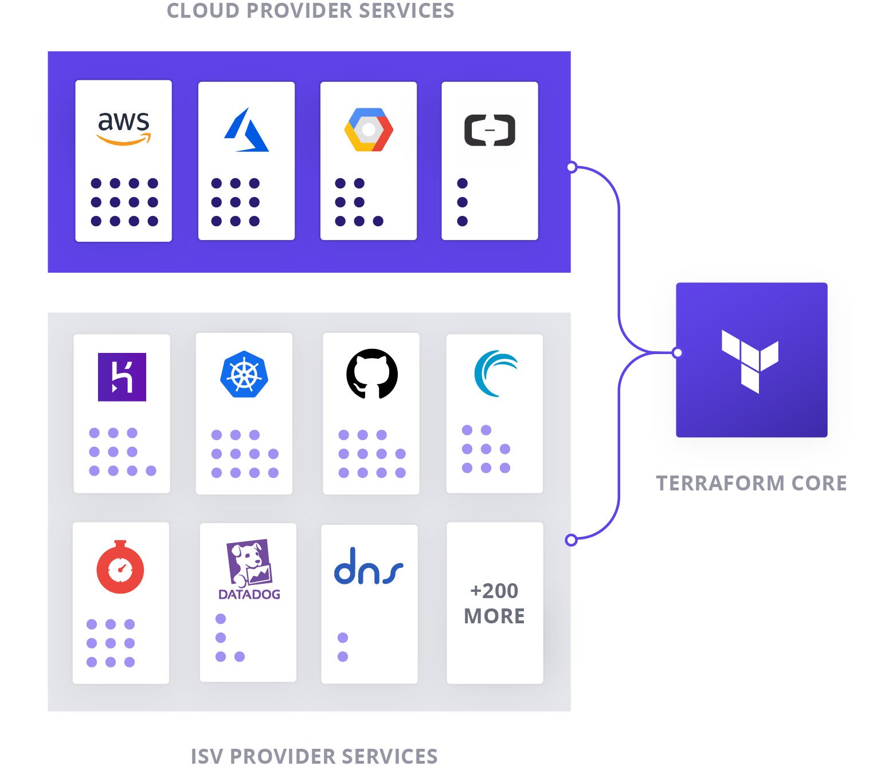
Cloud Provisioning with Terraform
A common Cloud Operating Model
Core + Provider Model
Expose the unique services of each infrastructure platform, but provide a consistent workflow
200+ Providers exist for any infrastructure or application element
Enabled by the open source model of 1200+ contributors

Slide 12
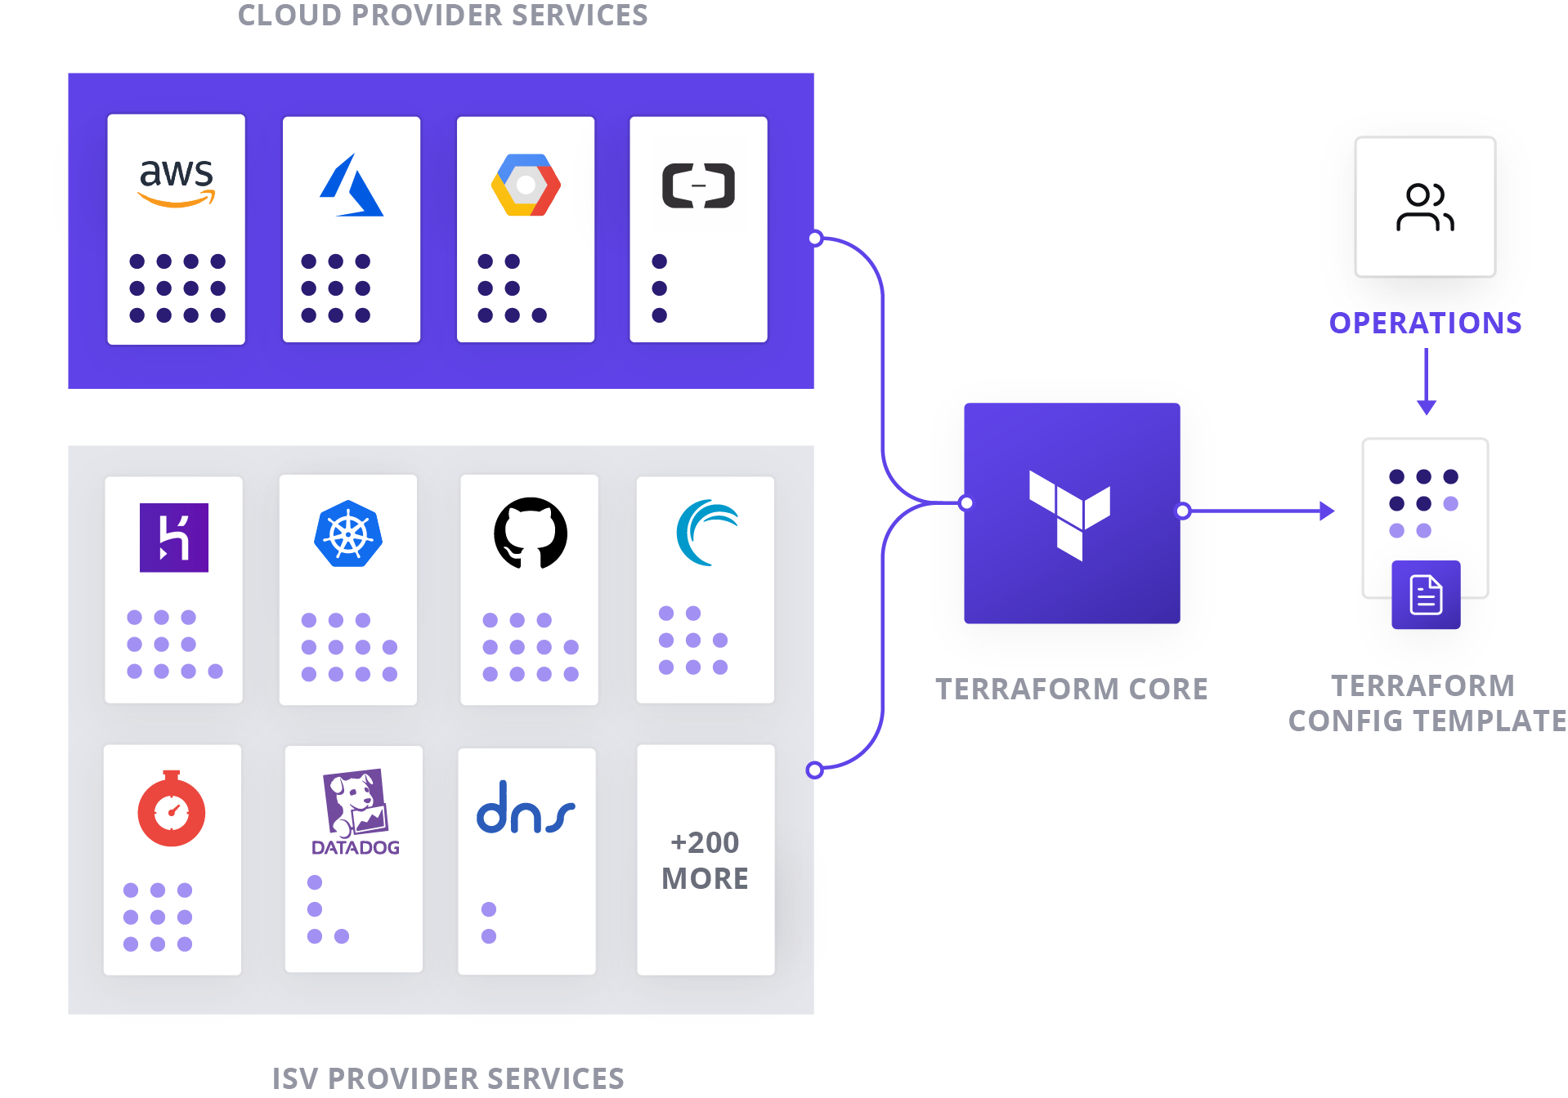
Cloud Provisioning with Terraform
A common Cloud Operating Model
A single Terraform template contains the entire infrastructure topology
Platform services AND the configuration of any dependancies
eg. 4 AWS services plus k8s

Slide 13
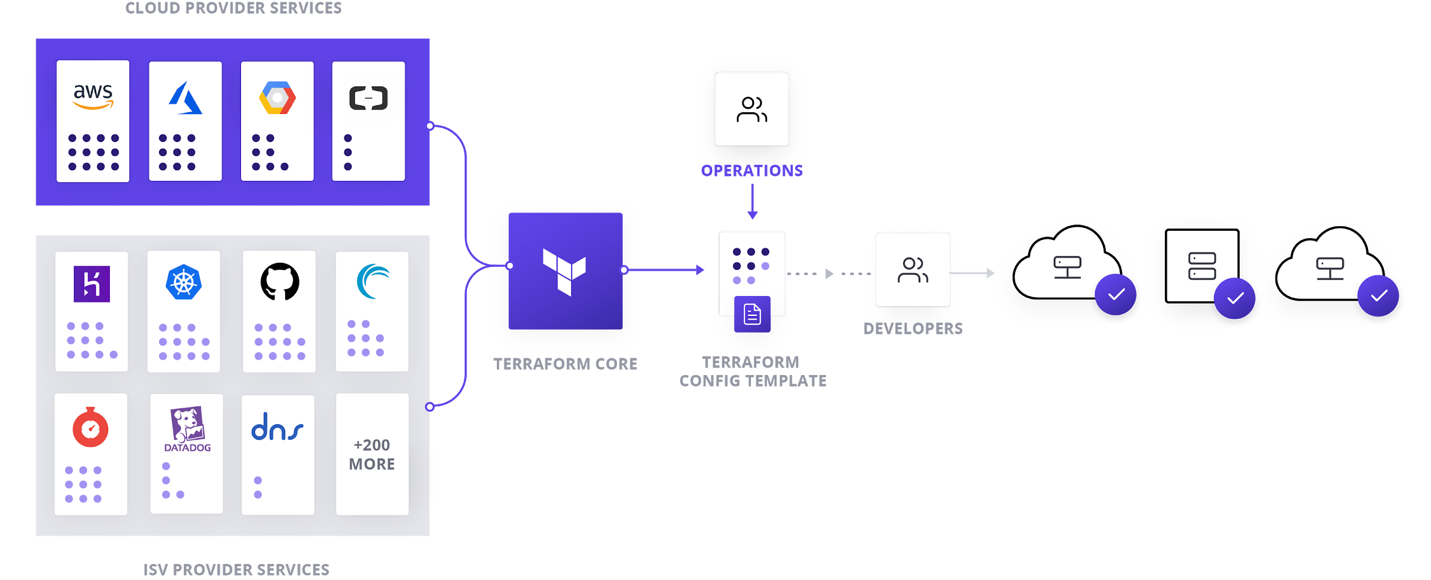
Cloud Provisioning with Terraform
A common Cloud Operating Model
Self Service Provisioning
Templates can be made available to any development team for self-provisioning
Multi-Cloud Provisioning & Compliance
Operations teams can enforce security & policy at provisioning time with Terraform Enterprise

Slide 14
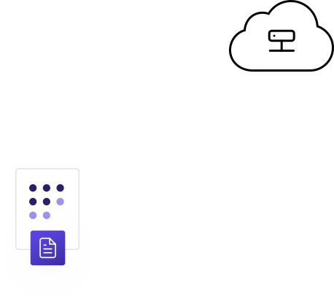
Cloud Provisioning with Terraform
A common Cloud Operating Model
Before
After
TFE
Developer or CI / CD System
Developer or CI / CD System
Policy
Governance
TF CLI
TF CLI
TF Template
TF Template
Codified policies enforce security, compliance, and operational best practices across all cloud provisioning

Slide 15
Static Infrastructure
Dynamic Infrastructure
The shift to provisioning dynamic infrastructure
Homogeneous, Private
Heterogeneous, Distributed
Homogeneous infrastructure provisioned for long periods of time with dedicated machines.
Traditional Approach
Manual workflows
Homogeneous infrastructure
Delegate with ticketing requests and queues
Heterogeneous infrastructure frequently provisioned and available on-demand.
Terraform Approach
Infrastructure as code
Embrace heterogeneity with extensible providers
Delegate with self-service modules and automated policy enforcement
USING TERRAFORM IN DYNAMIC INFRASTRUCTURE

Slide 16



Increased cost.
$10B overspent on cloud annually
Business Challenges of Dynamic Infrastructure
Reduced productivity.
Up to 70% of time is used rebuilding, debugging, or waiting.
Increased risk.
Larger surface area to secure, govern, and audit
TRADITIONAL APPROACH TO DYNAMIC INFRASTRUCTURE

Slide 17
Reduce cost.
Eliminate unnecessary spend by 30-40%
Business Value of Terraform
Increase productivity.
Engineers spend up to 70% less time on manual tasks.
Reduce risk.
One workflow to secure, govern, and audit.
TERRAFORM APPROACH TO DYNAMIC INFRASTRUCTURE

Slide 18



Terraform Use Cases
Infrastructure
as Code
Multi-Cloud Management
Self-Service Infrastructure
Adopt any cloud, infrastructure, or service safely, efficiently, and timely.
Use infrastructure as code to safely and efficiently provision and manage infrastructure at any scale.
Provision and manage public cloud, private infrastructure, and external services holistically while still preserving the uniqueness of each.
Provide a library of approved infrastructure that developers can use to safely and efficiently provision infrastructure on-demand.
TERRAFORM USE CASES

Slide 19
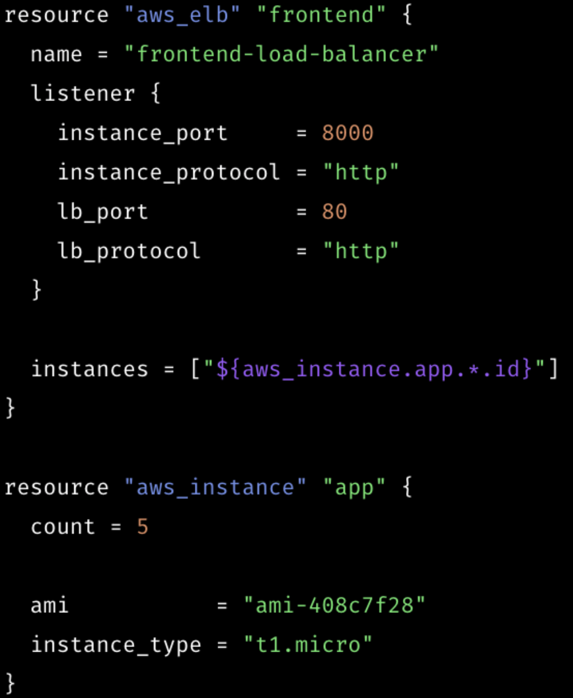
Terraform Principles
Automation through Codification
Create, share, collaborate, and provision infrastructure using code.
TERRAFORM PRINCIPLES

Slide 20
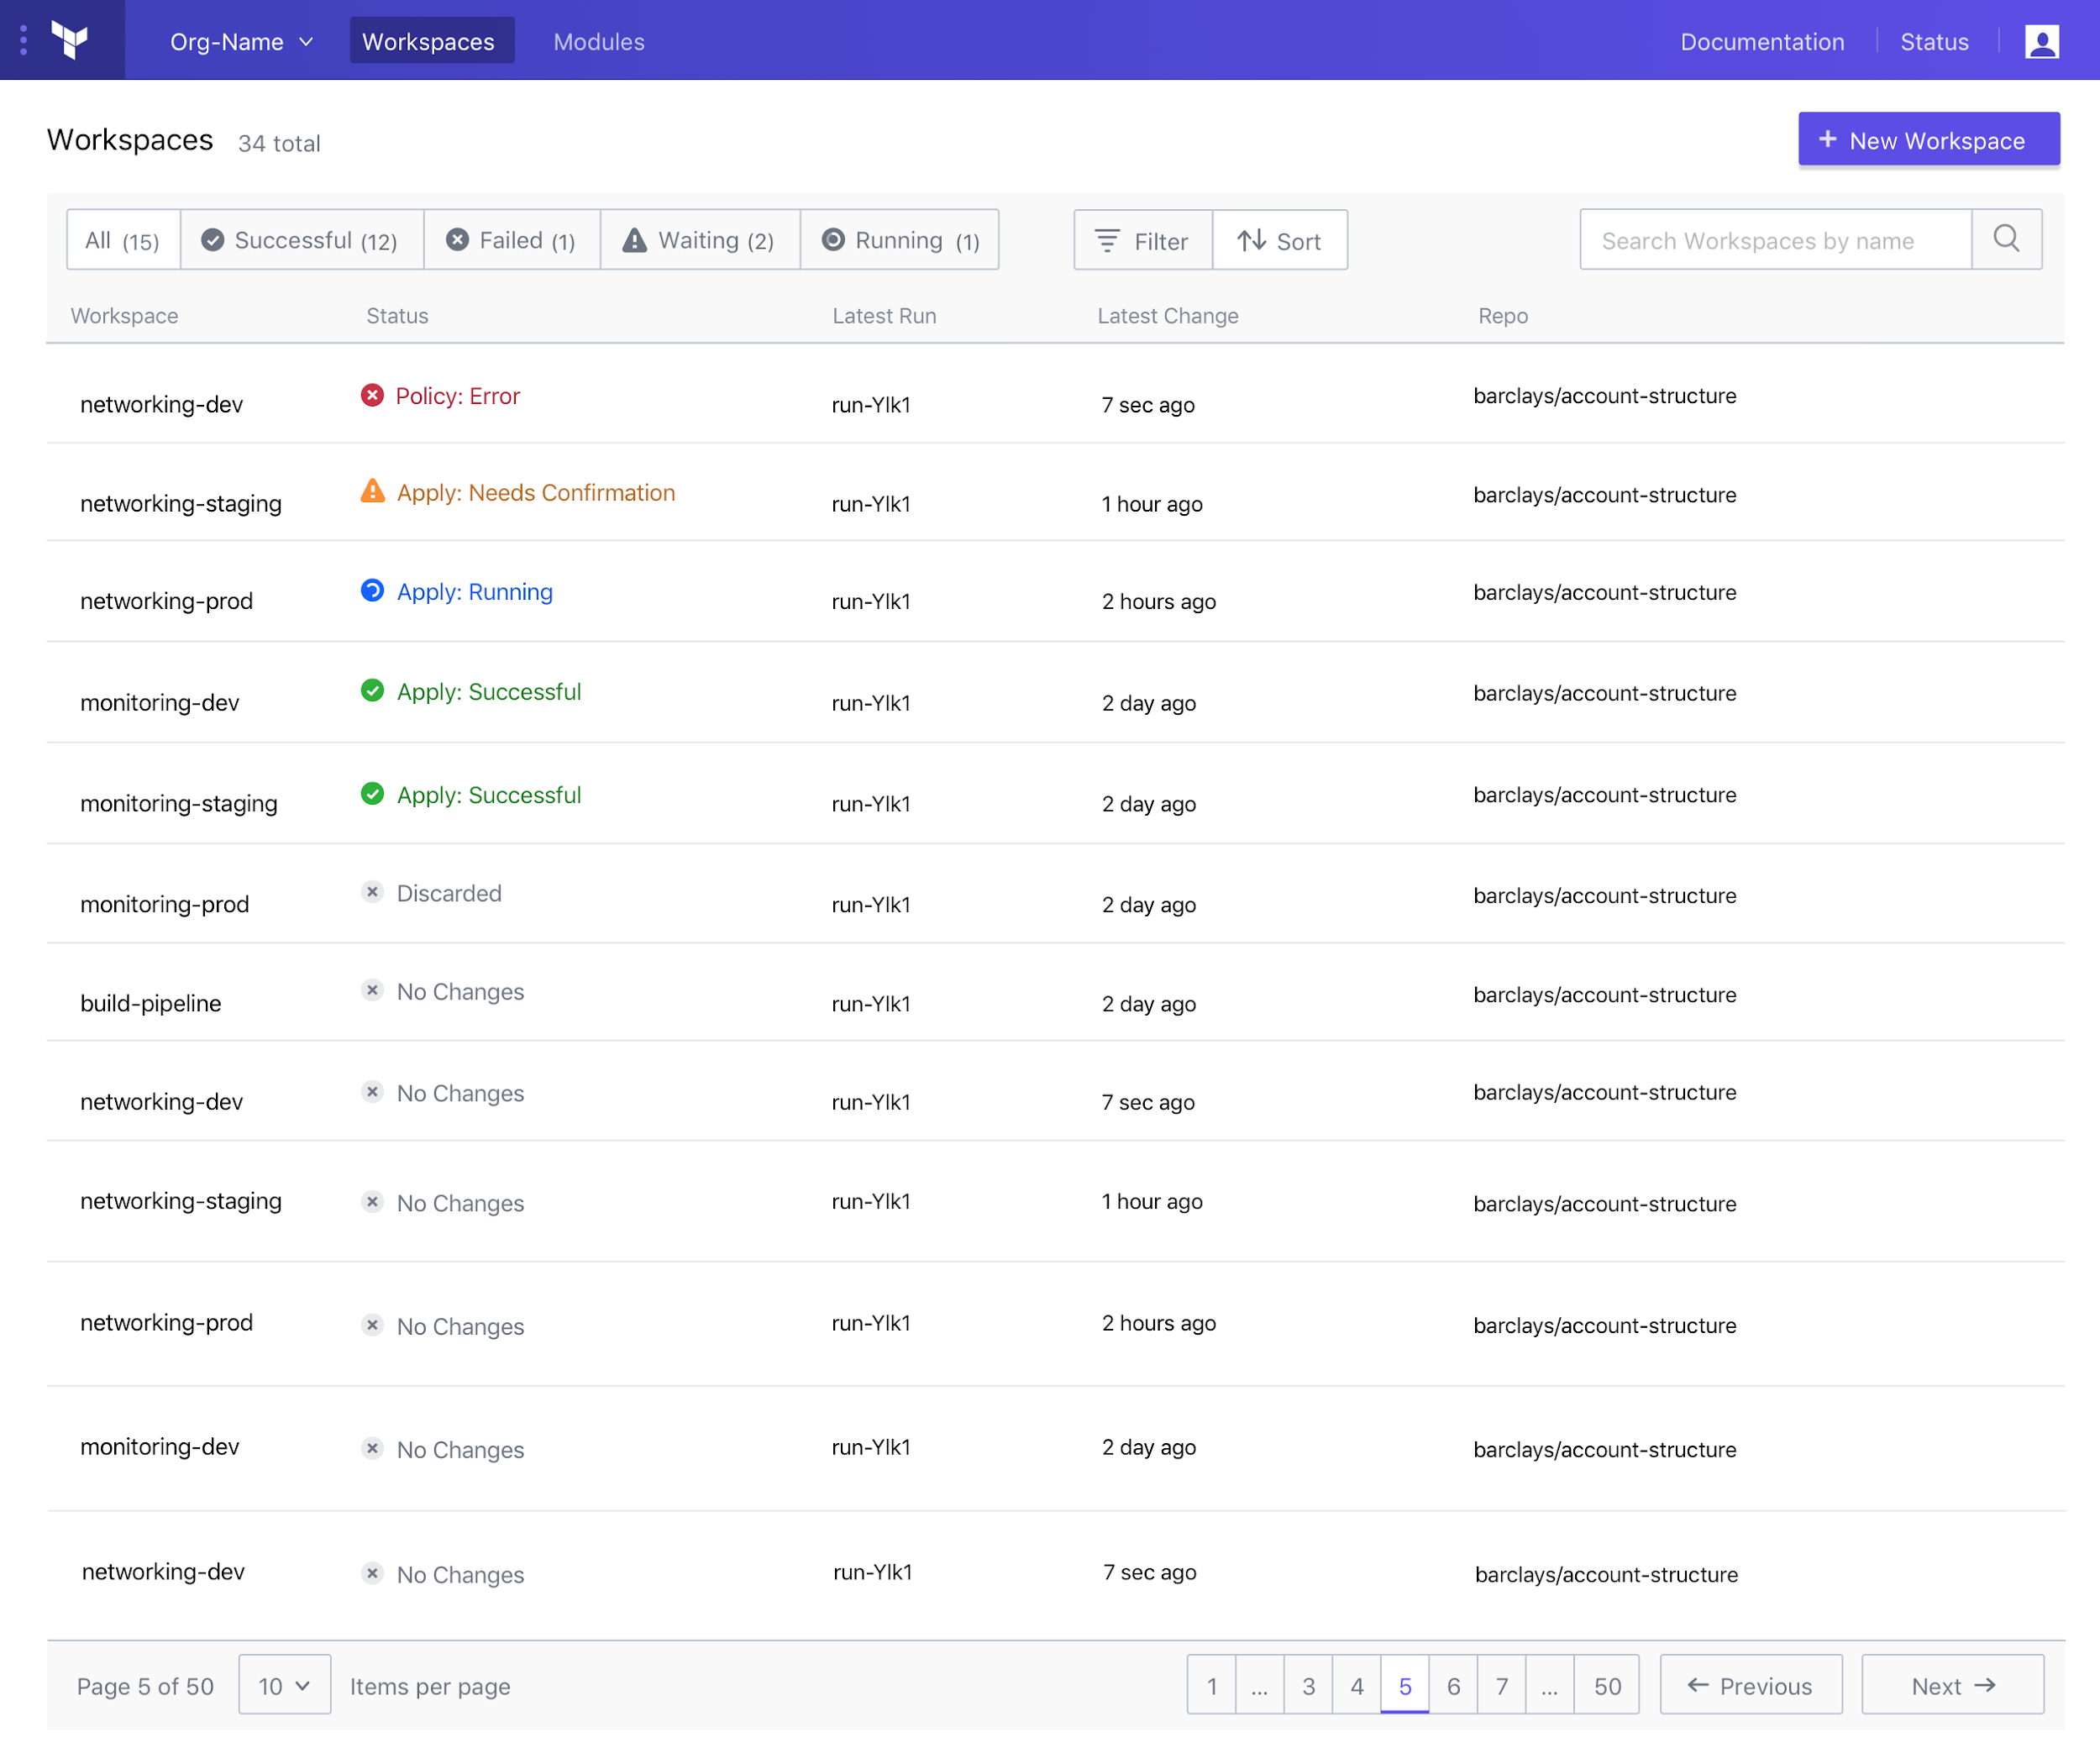
Terraform Principles
Workflows, not Technology
Use a consistent workflow to provision infrastructure while preserving uniqueness of each provider.
TERRAFORM PRINCIPLES

Slide 21
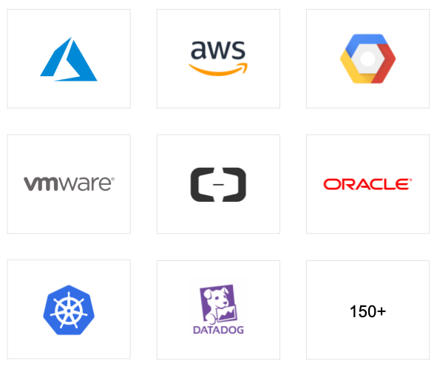
Terraform Principles
Open and Extensible
Leverage open source providers for broad support of common infrastructure and add your provider to support custom infrastructure.
TERRAFORM PRINCIPLES

Slide 22
Open Source vs. Enterprise
GOVERNANCE
ORGANIZATIONAL COMPLEXITY
POLICY
COLLABORATION
COLLABORATION
OPEN SOURCE
OPEN SOURCE
OPEN SOURCE
Individuals
Teams
Pro
Organizations
Premium

Slide 23
2014
Product Launch
About Terraform
1200+
Contributors
150+
Providers
12.5k+
GitHub Stars
20k+
Downloads Weekly
250+
Customers Worldwide
TERRAFORM ADOPTION

Slide 24




2014
Product Launch
About Vault
10.4K+
Github Stars
2T+
Transactions
1M+
Monthly Downloads
250+
Enterprise Customers Worldwide
VAULT ADOPTION

Slide 25
2014
Product Launch
About Consul
12K+
GitHub Stars
1M+
Monthly downloads
50k+
Used at scale with 50k+ agents
457
Contributors
CONSUL ADOPTION

Slide 26
Thank you
hello@hashicorp.com
www.hashicorp.com

